Slide 1
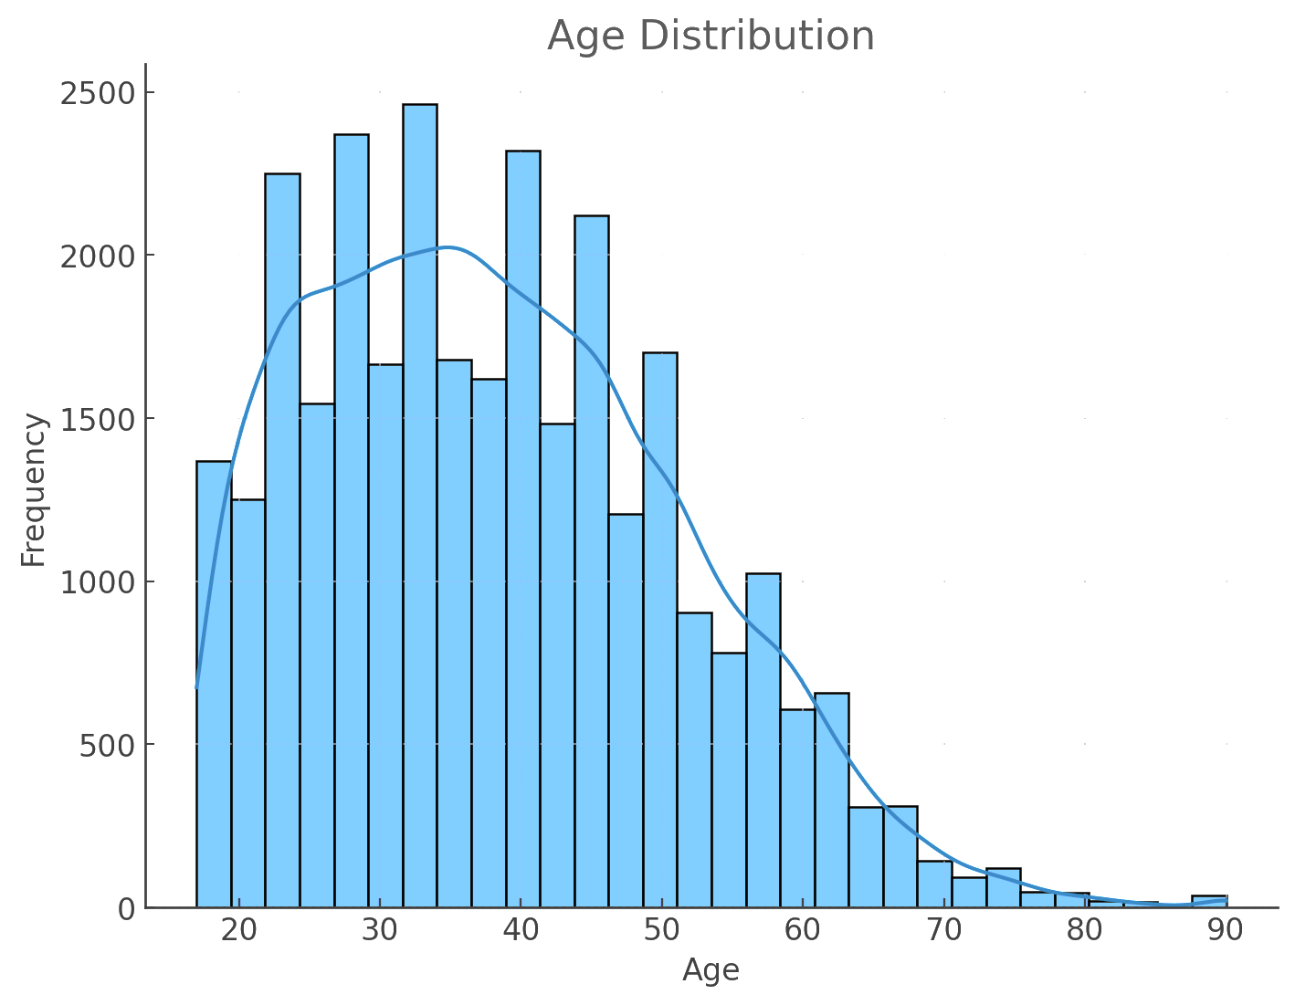
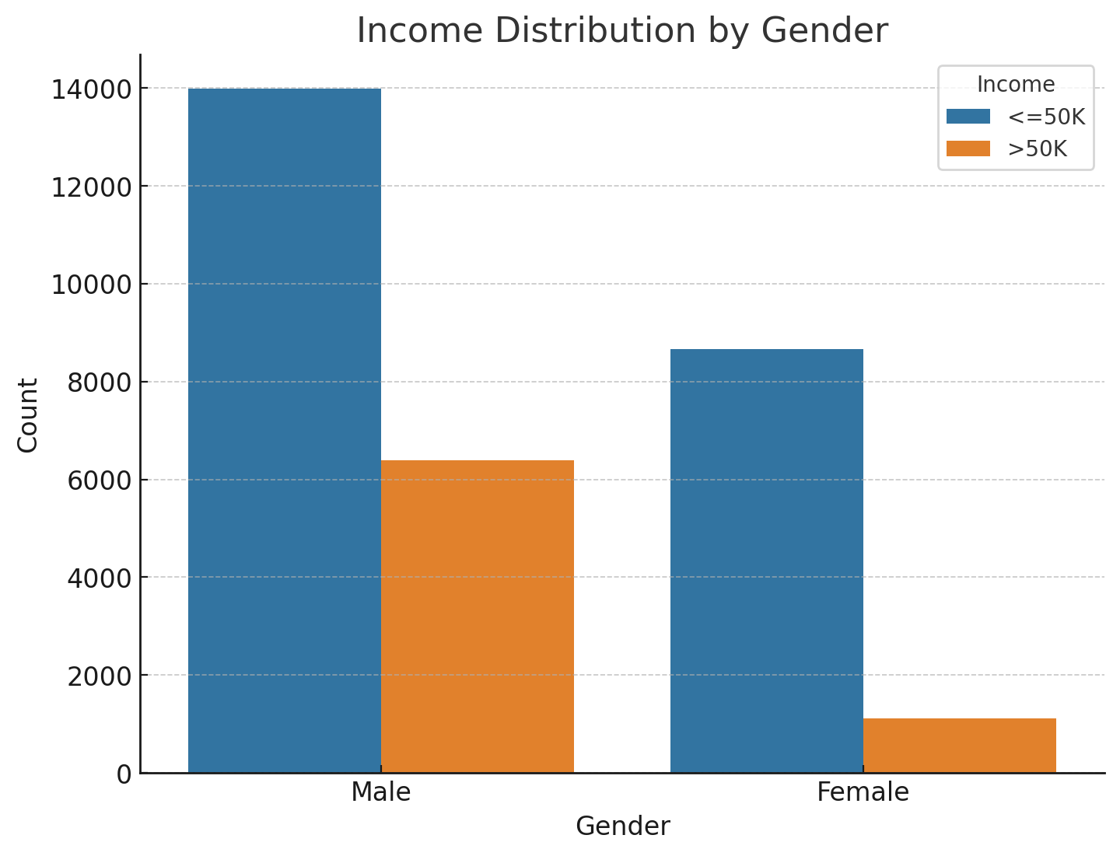
PREDICTIVE MODELING FOR INCOME CLASSIFICATION USING THE ADULT CENSUS DATASET
CSE 574: Machine Learning Project - Identifying High Earners in Census Data
Bhavika Sood
Introduction
Income classification is an essential task in socio-economic research, often used for market segmentation, policy-making, and financial planning. This study aims to predict whether an individual earns more than USD 50,000 per year using the Adult Census Income dataset. The dataset consists of various demographic attributes, including age, work class, education, marital status, occupation, race, gender, and native country. By employing data preprocessing and machine learning techniques, this project explores the relationship between these attributes and income, ultimately building a predictive model.
Data Analysis
The histogram of the age variable revealed that the dataset predominantly consists of working-age adults (20-60 years). The age distribution indicated possible income variations across different age groups, with higher frequencies in the younger working-age population.
The dataset includes various occupations, showing that executive, managerial, and professional roles are more likely in the ">50K" income group, while service, manual labor, and clerical jobs fall into the "<=50K" category. Self-employed and government workers also tend to earn more. Higher education, such as a bachelor's degree, strongly correlates with earning ">50K," while lower education levels align with the "<=50K" group. Marital status impacts income, with "Married-civ-spouse" individuals and the "Husband" role often linked to higher earnings, highlighting traditional gender dynamics.
Conclusion
The study successfully utilized machine learning techniques to classify individuals into income categories based on demographic data. With an accuracy of over 87.07%, the model proves to be a valuable tool for income prediction and socio-economic analysis. Further research could involve experimenting with different algorithms, incorporating additional features, or addressing class imbalance to improve predictive performance. The findings also highlight the potential for using demographic data in financial forecasting and economic policy development.
Results
MODEL ACCURACY
The Gradient Boosting Classifier achieved an accuracy of 87.07% on the test dataset, indicating a reliable performance in predicting income based on demographic features.
INDIVIDUALS EARNING >50K
The model predicted that 3,107 individuals in the test dataset earn more than USD 50,000 per year. A subset of these individuals is presented in a table to illustrate the typical demographic characteristics associated with higher income.
INCOME DISPARITIES
The high accuracy demonstrates the model's effectiveness in income classification, confirming that demographic factors like education, occupation, and marital status are significant predictors of income.
FEATURE IMPORTANCE
The model identified age, education level, and occupation as the most influential features in predicting income, underscoring their importance in economic outcomes.
Figure A: neque dignissim, and in aliquet nisl et umis.
Future Work
Feature Engineering: Investigating new features, such as interaction terms between variables, could improve model performance.
Model Optimization: Exploring other machine learning algorithms (e.g., Random Forest, Support Vector Machine) and hyperparameter tuning to enhance the model's predictive power.
Addressing Bias: Conducting a deeper analysis of the identified gender and racial disparities in income to address potential biases in the dataset.
Methods
DATA CLEANING
The dataset was first cleaned by removing rows with missing values and standardizing the format of the income column.
DATA TRANSFORMATION
The target variable (income) was converted into a binary classification, where 1 indicates ">50K" and 0 indicates "<=50K".
FEATURE ENCODING
Categorical columns were one-hot encoded to make the data suitable for modeling.
EXPLORATORY DATA ANALYSIS
Plots were created to explore the age distribution and income distribution by gender.
MODEL TRAINING
A Gradient Boosting Classifier was trained to predict the income level using the preprocessed training dataset.
A count plot indicated a significant disparity in income distribution between males and females, suggesting that gender plays a role in income levels. More males were classified as earning ">50K" compared to females, highlighting potential socio-economic factors influencing income disparity.
References
Becker, B. & Kohavi, R. (1996). Adult [Dataset]. UCI Machine Learning Repository https://doi.org/10.24432/C5XW20
Pandas: Powerful Python data analysis toolkit.
Harris, C. R., et al. (2020). Array programming with NumPy
Pedregosa, F., et al. (2011). Scikit-learn: Machine Learning in Python
Hunter, J. D. (2007). Matplotlib: A 2D Graphics Environment
School of Engineering and Applied Sciences University at Buffalo
buffalo.edu

